Slide 1
In search of longevity
A retrospective study
Brandon Vidro, Adarsh Balakrishnan, Dan Gilroy
Team B.A.D.

Slide 2
Motivation
Identify factors that influence life expectancy
Obtain data from around the world
Obtain inferential information from these predictors
Identify an optimal model to classify predictors as above or below average life expectancy
Leverage both predictive and inferential modelling
Use various feature selection techniques
Use factors that could be influenced

Slide 3
Data
Data - world development indicators from here:
https://www.kaggle.com/worldbank/world-development-indicators?select=Indicators.csv
As it has ~550 MB of world health data, a lot of factors to choose from.
The number of factors are high (~1344) to choose from, so it is expected to take some work to identify principal factors of concern
The number of years of data available is 55 over 247 country names.
A little over a million rows of data

Slide 4
Feature selection Part 1
The initial parameter set of 1344 features needed to be paired down to a more manageable number.
Initial criteria was to ensure the number of observations was much greater than the features.
A cutoff of 10000 observations per feature requirement was determined to be adequate from general exploratory analysis.
This reduced the amount of features from 1344 to 64. This reduced the overall number of observations for each feature to ~ 6260, do to inner join of data for features selected

Slide 5
Feature Selection 2 Prep
Since the data was stacked/tall, multiple transformations were needed.
Unstack data to obtain a wide, dense dataset with columns per feature.
Sparseness was eliminated by removing rows with missing values
Resultant dataset had 6260 rows of data.
As decision was made to attempt to reduce the parameters space to 10 features.
This would give over 600 rows per feature given 10 features in the final modelling set

Slide 6
Feature Selection Part 2
Starting the process of reducing the parameters space to 10 features.
An initial reduction of parameters was performed via domain experience, by removing features that would obviously be a functions of life expectancy or uncontrollable factors.
For example:
'Population ages 65 and above (% of total)' - this is essentially life expectancy
Year - uncontrollable and it is expected that life expectancy increases over time

Slide 7
Feature Select Part 3
Use an iterative process, as follows, until a feature set of 10 was attained
Identify features
Using two techniques
Forward selection
Lasso
Review features selected for both
Are these features highly correlated?
Yes - remove highest feature with highest Variance Inflation Factor (VIF)
Finally - use the features set (Forward Selection or Lasso) based on performance

Slide 8
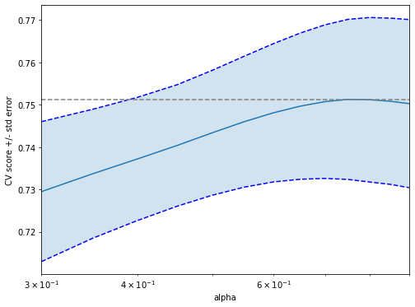
Feature Selection Part 3 Deep Dive
Lasso selection involved identifying the optimal lambda (alpha in the plot) via cross validation.
This lambda was used for the feature selection.
Illustration of lambda selection process during cross validation.

Slide 9
Identifying Classification model
Classification was performed based on the average life expectancy for a given year.
The following models were optimized (where appropriate) and run on the data:
KNN (n=5)
Logistic Regression
Multi-Layer Perceptron (solver='adam', activation='tanh', hidden layers=(5,2)
Random Forest (features per split 3, criterion gini
All model comparisons were performed via 10 fold cross validation

Slide 10
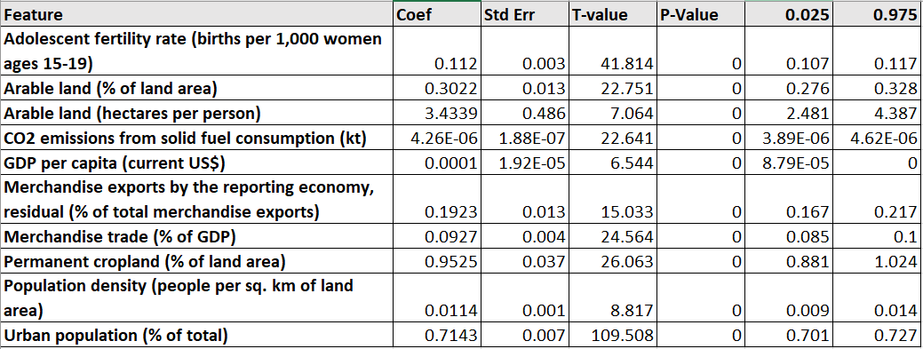
Features selected - inference information

Slide 11
Inference interpretation
All the coefficients where extremely significant and positively correlated with life expectancy.
With an F-statistic of 1.572e+04 resulting in essentially 0 P-Value, the model is considered significant.
The top 3 impactful coefficients in terms of scale would be:
Arable land (hectares per person)Permanent cropland (% of land area)
Permanent cropland (% of land area)
Urban population (% of total)

Slide 12
Regression models explored
Various regression models were explored to see how prediction accuracy performed.
Multi-Layer Perceptron: 0.569
KNN (n=12): 0.75
Multilinear: 0.754
Random Forest: 0.88
Notes:
Random Forest regression outperformed the others

Slide 13
Classification Model Results
Accuracy Scores
KNN: 0.845
Logistic Regression: 0.855
Multi-Layer Perceptron: 0.819
Random Forest: 0.893
Notes:
KNN performed well due to dense space for prediction
Random Forest performance was optimal

Slide 14
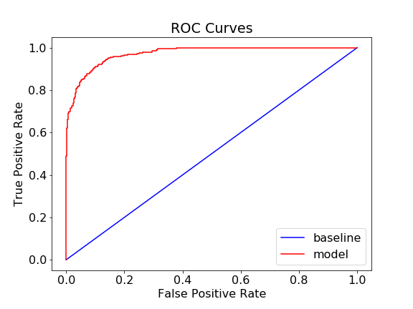
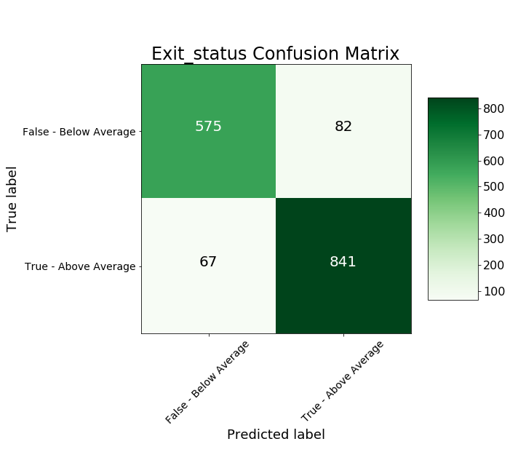
Classification Model Chosen
Random Forest Classification model performed best (sample 3:1 train/test):

Slide 15
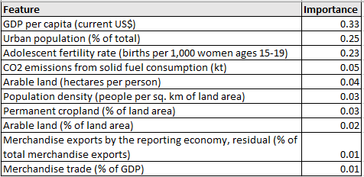
Random Forest Importance information
The importance information obtained from Random Forest Classifier
It is interesting to note the difference in rankings between the multiple linear regression coefficients and the Random Classifier. It could be the scale of the feature.

Slide 16
Conclusions
Initial conclusions indicate that the following factors are key contributors to life expectancy:
GDP per capita (current US$)
Adolescent fertility rate (births per 1,000 women ages 15-19)
Arable land (hectares per person)
Permanent cropland (% of land area)
Urban population (% of total)
With Urban population being the overlapping feature in both the Random Forest Classifier Importance and Multilinear regression models coefficients weight

Slide 17
Conclusions Continued
Random Forest outperformed all other models tested, for both linear and classification.
This could be due to underlying non-linearity of the data.
However the multilinear regression model was second, and would probably perform better when extrapolating to life expectancy outside the range of data presented in its training samples.

Slide 18
Future work
Revisit predictor selection leveraging all the following models
Forward Selection
Backward Selection
Forward/Backward Selection Combinations
Lasso
Random Forest Importance selection
Automate the feature selection
Parameter exclusion based on VIF
Dig deeper into the differences presented in MultiLinear regression coefficient ranks vs the Feature Importance identified in the Random Forest modelling
Is it just the scale of data causing the difference? If so, what can be done?

